Slide 1

HYTAN BIO TECH
Custom Oral Film
Solutions for Global
Health Brands
ORAL DISSOLVING FILMS
PRODUCT BROCHURE
Hongkong Hytan Biotech CO. Ltd
2026 / Products & Custom Services
Notes:
Content source: the user-supplied Chinese oral film brochure, page 1. Brand and contact details follow the user's instructions. Visual references: https://www.oralstripsoem.com/ and https://www.petoralstrips.com/ .

Slide 2
HYTAN BIO TECH
ORAL FILM INNOVATION
Company Overview
CONTENTS
01
About HYTAN BIO TECH
03
02
Why Choose HYTAN BIO TECH
04
03
Advantages of Oral Films
05
04
Quality & Certification References
06
05
Custom Service Process
07
06
Product Portfolio
08-27
07
Flavor Customization
28-29
Hongkong Hytan Biotech CO. Ltd
02
Notes:
Content source: the user-supplied Chinese oral film brochure, page 2. Brand and contact details follow the user's instructions. Visual references: https://www.oralstripsoem.com/ and https://www.petoralstrips.com/ .

Slide 3
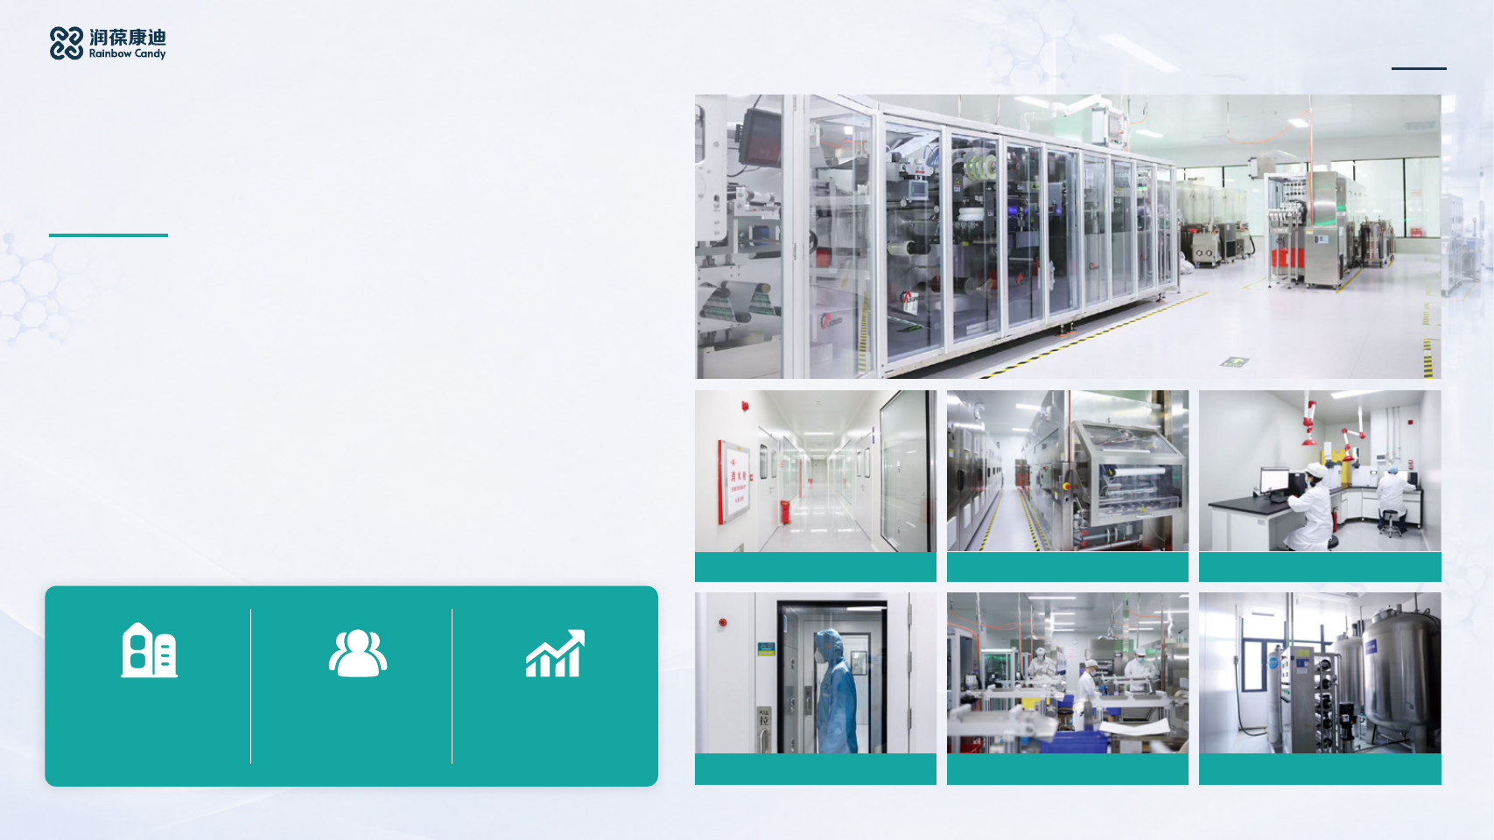
HYTAN BIO TECH
ORAL FILM INNOVATION
About
HYTAN BIO TECH
Hongkong Hytan Biotech CO. Ltd is an innovative oral film company integrating
research, manufacturing and sales. Our vision is to become a leading global
provider of innovative oral film solutions. Full value-chain capabilities support daily
output of 2 million films and annual capacity of more than 600 million films, serving
diverse global orders. Factory workshops follow GMP standards and use
automated high-speed production lines and advanced clean-air systems.
Operations follow GMP standards, with quality management based on ISO 22000
and ISO 9001.
As a health technology innovator, HYTAN BIO TECH follows a philosophy of films
as thin as wings and close to the heart. We connect oral mucosal delivery with
CLEAN
everyday health applications to provide global users with more convenient,
ROOM
efficient and safe health management solutions.
Class 100,000 Cleanroom
Automated High-Speed Line
Testing Center
Class 100,000
200+
2M+
Cleanroom
R&D and Production Staff
Films per Day
Air Shower
Packaging Line
Water Treatment Room
03
Notes:
Content source: the user-supplied Chinese oral film brochure, page 3. Brand and contact details follow the user's instructions. Visual references: https://www.oralstripsoem.com/ and https://www.petoralstrips.com/ .

Slide 4
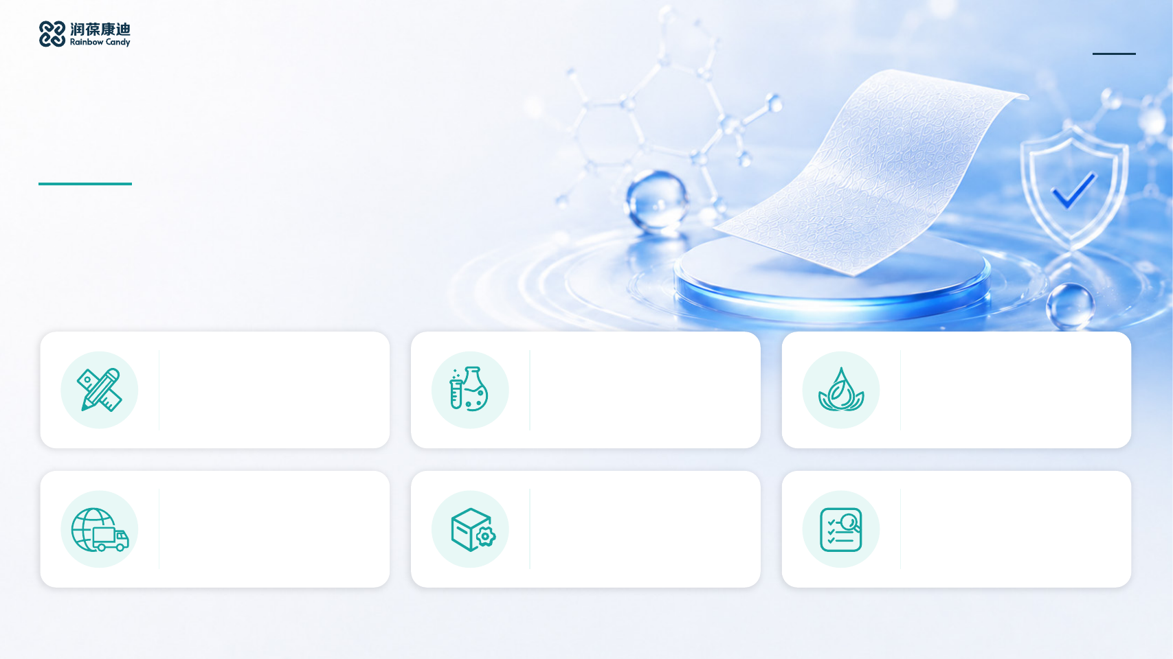
HYTAN BIO TECH
ORAL FILM INNOVATION
Why Choose
HYTAN BIO TECH
An oral film R&D and manufacturing partner for global brands, offering
one-stop solutions from formulation and custom design to scaled production.
Personalized Design
Custom Formulation
Flavor Selection
Custom packaging and visual
Professional nutritionists develop
100+ flavor options to meet the
design aligned with your positioning
tailored formulations for the needs
preferences of different markets and
to create a distinctive brand identity.
of different groups.
consumers.
Fast Delivery
Manufacturing Capacity
Compliance & Quality
Standard orders ship within 20
Four automated high-speed lines
Global regulatory and quality
days. Urgent orders can receive
deliver more than 600 million films
standards guide a comprehensive,
priority production and dispatch.
annually, with industry-leading
strict quality control system.
scale.
04
Notes:
Content source: the user-supplied Chinese oral film brochure, page 4. Brand and contact details follow the user's instructions. Visual references: https://www.oralstripsoem.com/ and https://www.petoralstrips.com/ .

Slide 5

HYTAN BIO TECH
ORAL FILM INNOVATION
Advantages of Oral Films
Fast-dissolving oral films combine convenience, efficient absorption and an improved everyday health experience.
Oral Films vs. Other Dosage Forms
 | Oral Film | Gummy | Capsule | Tablet
Bioavailability* | 50-80% | 20-40% | 15-30% | 10-25%
Absorption Speed | Fast | Slow | Slow | Slow
Swallowing | Not required | Required | Required | Required
Use | Dissolves in mouth | No water needed | With water | With water
Gastrointestinal Burden | None | Present | Present | Present
*Bioavailability ranges reflect common industry observations. Actual results may vary with formulation, active ingredients and individual physiology.
No Swallowing Difficulty
Portable & Discreet
Pleasant Experience
High Bioavailability
Dissolves in the mouth without water or
Average film thickness is approximately
Avoids the bitterness and foreign-body
Bypasses the gastrointestinal tract and liver
swallowing. Suitable for older adults,
0.08 mm. Individually wrapped films are
sensation of conventional tablets, with
first-pass effect. Actives absorb through oral
children and people with swallowing
easy to carry.
pleasant taste and high user
mucosa, with onset in 5-10 minutes.
difficulties.
acceptance.
05
Notes:
Content source: the user-supplied Chinese oral film brochure, page 5. Brand and contact details follow the user's instructions. Visual references: https://www.oralstripsoem.com/ and https://www.petoralstrips.com/ .

Slide 6
HYTAN BIO TECH
ORAL FILM INNOVATION
Quality & Certification References
Product quality and safety supported by internationally recognized certification frameworks.
Kosher
Kosher certification
Halal
Halal certification
GMP
Good Manufacturing Practice
ISO 9001
Quality Management System
ISO 22000
Food Safety Management System
Certification references derive from the original brochure. Ownership, scope and validity remain subject to
the original certificates and must be verified for each project.
06
Notes:
Content source: the user-supplied Chinese oral film brochure, page 6. Brand and contact details follow the user's instructions. Visual references: https://www.oralstripsoem.com/ and https://www.petoralstrips.com/ .

Slide 7

HYTAN BIO TECH
ORAL FILM INNOVATION
Custom Service Process
Fast responses and transparent project tracking support efficient, dependable customization.
01
02
03
Requirements Discussion
Formulation Approval
Sample Approval
04
05
06
Order Confirmation
Deposit Payment
Manufacturing
07
08
09
Balance Payment
Packing & Dispatch
After-Sales Service
07
Notes:
Content source: the user-supplied Chinese oral film brochure, page 7. Brand and contact details follow the user's instructions. Visual references: https://www.oralstripsoem.com/ and https://www.petoralstrips.com/ .

Slide 8
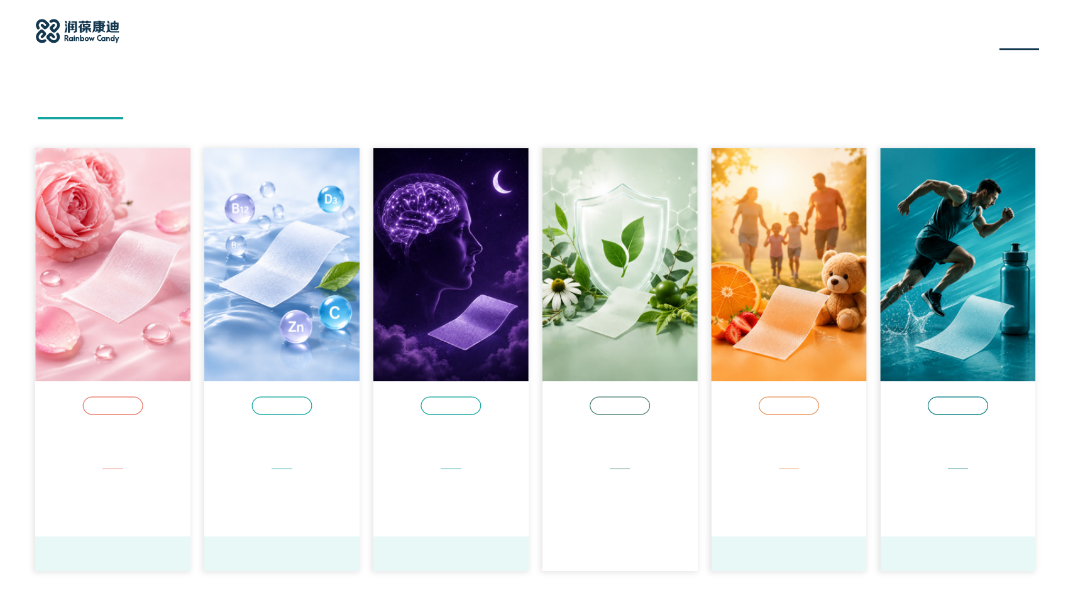
HYTAN BIO TECH
ORAL FILM INNOVATION
Product Categories
Category
Category
Category
Category
Category
Category
Beauty & Healthy
Essential Nutrition
Brain Health & Sleep
Immunity &
Children &
Sports Health
Aging
Long-Term Health
Special Populations
Women's Health
Beauty, antioxidants and
Daily vitamins, minerals
Sleep, relaxation and
Immune, cardiovascular,
Nutrition for children,
Energy, hydration, sports
women's health support
and essential nutrition
cognitive focus support
liver and metabolic support
pregnancy, postpartum and
performance and recovery
older adults
A
B
C
D
E
F
08
Notes:
Content source: the user-supplied Chinese oral film brochure, page 8. Brand and contact details follow the user's instructions. Visual references: https://www.oralstripsoem.com/ and https://www.petoralstrips.com/ .

Slide 9
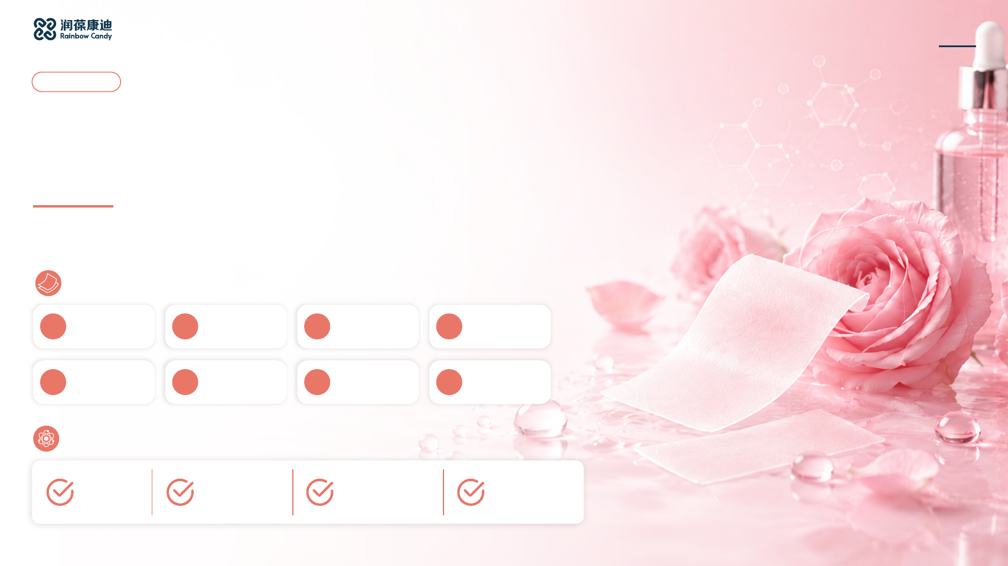
HYTAN BIO TECH
ORAL FILM INNOVATION
Category A
Beauty & Healthy Aging
& Women's Health
Customizable oral film solutions for skin beauty, antioxidant support, healthy aging and
women's health.
Product Range
A1
Collagen Firming
A2
Hyaluronic Acid
A3
Antioxidant
A4
Anti-Glycation &
Film
Hydration
Brightening
Aging
A5
CoQ10 Energy
A6
Ergothioneine
A7
Menstrual Comfort
A8
Menopause
Film
Antioxidant
Film
Support Film
Key Benefits
Skin firmness
Moisture &
Brightening &
Women's health
& elasticity
hydration
antioxidants
09
Notes:
Content source: the user-supplied Chinese oral film brochure, page 9. Brand and contact details follow the user's instructions. Visual references: https://www.oralstripsoem.com/ and https://www.petoralstrips.com/ .

Slide 10

HYTAN BIO TECH
ORAL FILM INNOVATION
Beauty, Healthy Aging & Women's Health
Customizable oral film solutions for skin beauty, antioxidant support, healthy aging and women's health.
A1
A2
A3
A4
Collagen Firming
Hyaluronic Acid
Antioxidant
Anti-Glycation &
Hydration
Brightening
Healthy Aging
Oral Dissolving Film
Oral Dissolving Film
Oral Dissolving Film
Oral Dissolving Film
Key Ingredients
Key Ingredients
Key Ingredients
Key Ingredients
Collagen peptides
Hyaluronic acid
Glutathione
Carnosine
Vitamin C
Vitamin C
Vitamin C
OPC (proanthocyanidins)
Zinc
Benefits
Benefits
Benefits
Benefits
Skin elasticity and firmness
Moisturization and hydration
Antioxidant and brightening
Anti-glycation support
Healthy skin structure
Maintains skin moisture
Oxidative stress protection
Healthy aging support
Healthy skin appearance
Smooth skin support
Even skin tone support
Skin vitality support
10
Notes:
Content source: the user-supplied Chinese oral film brochure, page 10. Brand and contact details follow the user's instructions. Visual references: https://www.oralstripsoem.com/ and https://www.petoralstrips.com/ .

Slide 11

HYTAN BIO TECH
ORAL FILM INNOVATION
Beauty, Healthy Aging & Women's Health
Customizable oral film solutions for skin beauty, antioxidant support, healthy aging and women's health.
A5
A6
A7
A8
CoQ10 Energy
Ergothioneine
Menstrual Comfort
Menopause Support
Antioxidant
Oral Dissolving Film
Oral Dissolving Film
Oral Dissolving Film
Oral Dissolving Film
Key Ingredients
Key Ingredients
Key Ingredients
Key Ingredients
Coenzyme Q10
Ergothioneine
Magnesium
Soy isoflavones
Vitamin B2
Vitamin C
Vitamin B6
Calcium
Vitamin D
Benefits
Benefits
Benefits
Benefits
Cellular energy support
Antioxidant action
Menstrual health support
Menopause health support
Antioxidant support
Cellular protection support
Muscle relaxation support
Bone health support
Daily vitality support
Healthy aging support
Menstrual comfort support
Women's health support
11
Notes:
Content source: the user-supplied Chinese oral film brochure, page 11. Brand and contact details follow the user's instructions. Visual references: https://www.oralstripsoem.com/ and https://www.petoralstrips.com/ .

Slide 12
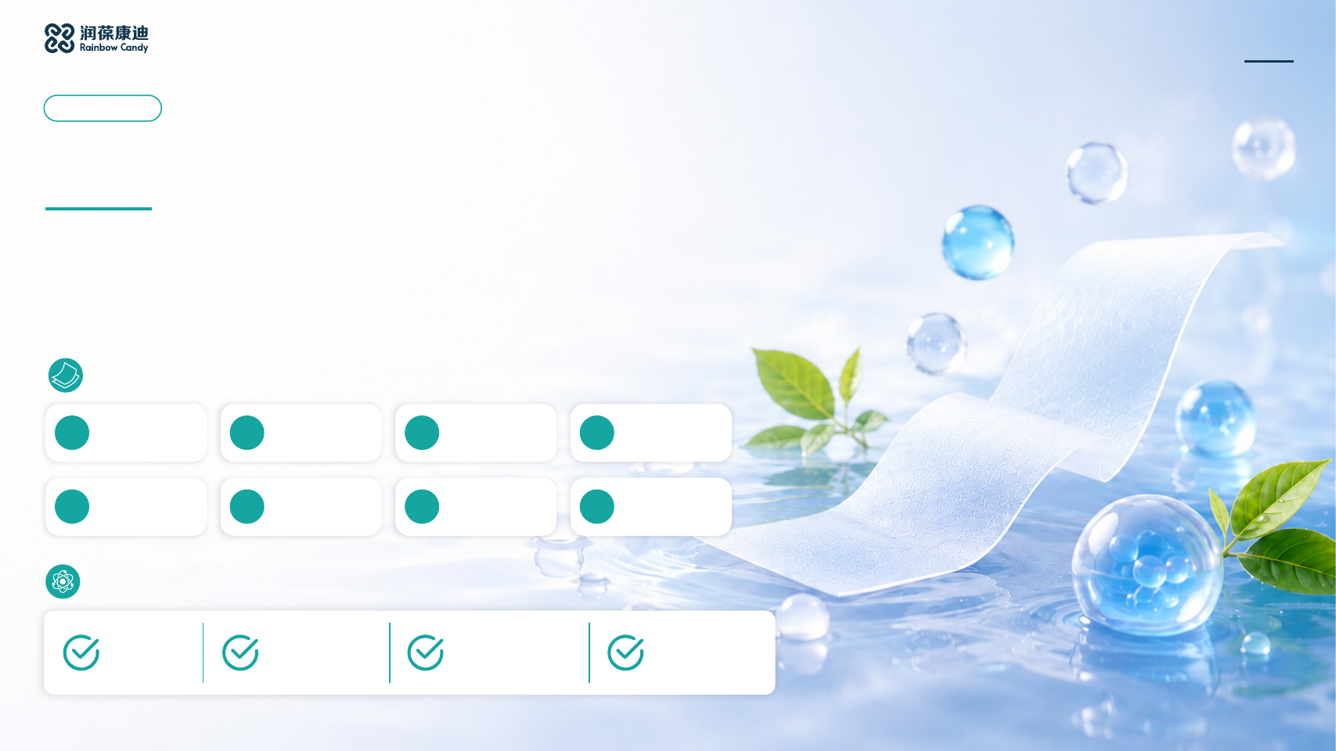
HYTAN BIO TECH
ORAL FILM INNOVATION
Category B
Essential Nutrition
Oral film solutions with daily vitamins, minerals and essential nutrients to meet the nutritional needs
of different groups.
Product Range
B1
Vitamin C
B2
Vitamin C + Zinc
B3
Vitamin D Calcium
B4
Vitamin D3 + K2
Immunity
Immunity
Uptake
Bones
B5
Vitamin B12 Nerve
B6
Vitamin B
B7
DHA Nutrition Film
B8
Biotin Hair Health
Support
Complex
Key Benefits
Immune
Bone health
Nerves & energy
Hair, skin & brain
health
nutrition
12
Notes:
Content source: the user-supplied Chinese oral film brochure, page 12. Brand and contact details follow the user's instructions. Visual references: https://www.oralstripsoem.com/ and https://www.petoralstrips.com/ .

Slide 13

HYTAN BIO TECH
ORAL FILM INNOVATION
Essential Nutrition
Oral film solutions with daily vitamins, minerals and essential nutrients to meet the nutritional needs of different groups.
B1
B2
B3
B4
Vitamin C Immunity
Vitamin C + Zinc
Vitamin D Calcium
Vitamin D3 + K2 Bone
Immunity
Absorption
Health
Oral Dissolving Film
Oral Dissolving Film
Oral Dissolving Film
Oral Dissolving Film
Key Ingredients
Key Ingredients
Key Ingredients
Key Ingredients
Vitamin C
Vitamin C
Vitamin D3
Vitamin D3
Zinc
Calcium
Vitamin K2 (MK-7)
Benefits
Benefits
Benefits
Benefits
Immune support
Immune support
Bone health
Calcium metabolism support
Antioxidant protection
Antioxidant protection
Calcium absorption support
Strong bones support
Collagen formation support
Cellular health support
Dental health support
Healthy calcium utilization
13
Notes:
Content source: the user-supplied Chinese oral film brochure, page 13. Brand and contact details follow the user's instructions. Visual references: https://www.oralstripsoem.com/ and https://www.petoralstrips.com/ .

Slide 14

HYTAN BIO TECH
ORAL FILM INNOVATION
Essential Nutrition
Oral film solutions with daily vitamins, minerals and essential nutrients to meet the nutritional needs of different groups.
B5
B6
B7
B8
Vitamin B12 Nerve
Vitamin B Complex
DHA Nutrition
Biotin Hair Health
Support
Oral Dissolving Film
Oral Dissolving Film
Oral Dissolving Film
Oral Dissolving Film
Key Ingredients
Key Ingredients
Key Ingredients
Key Ingredients
Vitamin B12
Vitamin B1
DHA
Biotin
Vitamin B2
Zinc
Vitamin B6
Benefits
Benefits
Benefits
Benefits
Nervous system support
Energy metabolism
Brain nutrition support
Hair and nail health
Energy metabolism support
Nervous system support
Cognitive health support
Skin health support
Red blood cell formation
Daily vitality support
Nervous system support
Keratin formation support
14
Notes:
Content source: the user-supplied Chinese oral film brochure, page 14. Brand and contact details follow the user's instructions. Visual references: https://www.oralstripsoem.com/ and https://www.petoralstrips.com/ .

Slide 15
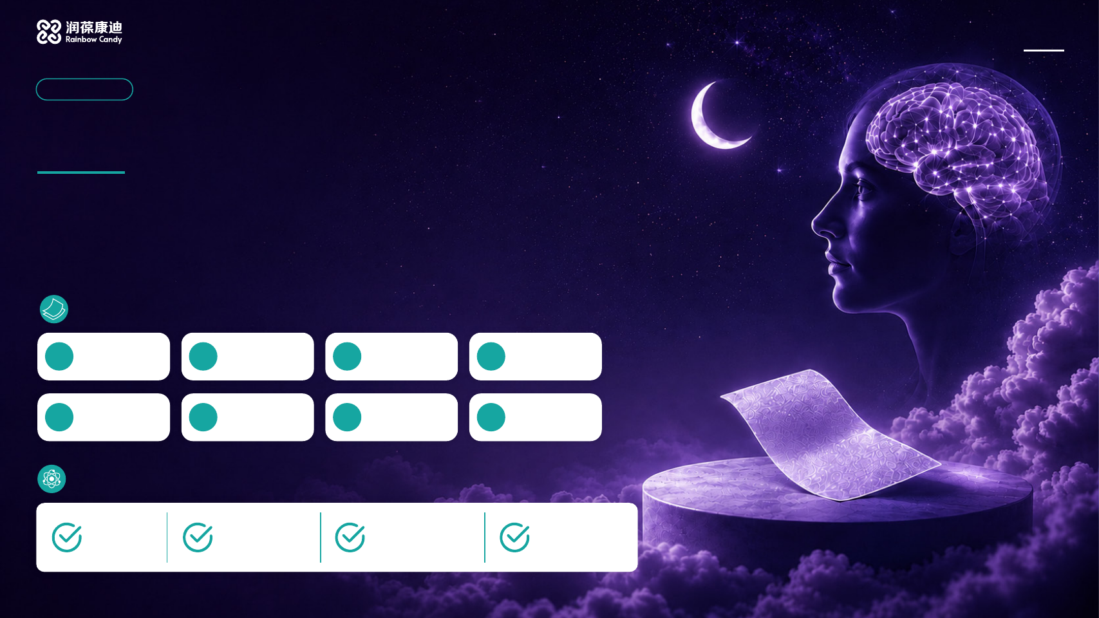
HYTAN BIO TECH
ORAL FILM INNOVATION
Category C
Brain Health & Sleep
Targeted oral film supplements for sleep, relaxation, cognitive focus and everyday mental
well-being.
Product Range
C1
Melatonin Sleep
C2
Melatonin +
C3
L-Theanine
C4
Focus & Learning
Film
Magnesium
Relaxation
Film
C5
Magnesium
C6
DHA Memory Film
C7
B Vitamins
C8
Caffeine Alertness
Relaxation
Anti-Fatigue
Film
Key Benefits
Sleep onset
Sleep quality
Calm & relaxation
Focus, memory &
alertness
15
Notes:
Content source: the user-supplied Chinese oral film brochure, page 15. Brand and contact details follow the user's instructions. Visual references: https://www.oralstripsoem.com/ and https://www.petoralstrips.com/ .

Slide 16

HYTAN BIO TECH
ORAL FILM INNOVATION
Brain Health & Sleep
Targeted oral film supplements for sleep, relaxation, cognitive focus and everyday mental well-being.
C1
C2
C3
C4
Melatonin Sleep
Melatonin +
L-Theanine Relaxation
Focus & Learning
Magnesium
Oral Dissolving Film
Oral Dissolving Film
Oral Dissolving Film
Oral Dissolving Film
Key Ingredients
Key Ingredients
Key Ingredients
Key Ingredients
Melatonin
Melatonin
L-theanine
L-theanine
Magnesium
Low-dose caffeine
Benefits
Benefits
Benefits
Benefits
Helps with sleep onset
Improves sleep quality
Emotional relaxation
Improves focus
Healthy sleep cycle support
Relaxation support
Stress management support
Improves mental alertness
Nighttime relaxation
Healthy sleep cycle support
Calm focus support
Sustained focus support
16
Notes:
Content source: the user-supplied Chinese oral film brochure, page 16. Brand and contact details follow the user's instructions. Visual references: https://www.oralstripsoem.com/ and https://www.petoralstrips.com/ .

Slide 17

HYTAN BIO TECH
ORAL FILM INNOVATION
Brain Health & Sleep
Targeted oral film supplements for sleep, relaxation, cognitive focus and everyday mental well-being.
C5
C6
C7
C8
Magnesium Relaxation
DHA Memory
B Vitamins
Caffeine Alertness
Anti-Fatigue
Oral Dissolving Film
Oral Dissolving Film
Oral Dissolving Film
Oral Dissolving Film
Key Ingredients
Key Ingredients
Key Ingredients
Key Ingredients
Magnesium
DHA
Vitamin B complex
Caffeine
Benefits
Benefits
Benefits
Benefits
Relaxation
Memory support
Mental well-being support
Improves alertness
Muscle relaxation support
Cognitive health support
Energy metabolism support
Improves focus
Nervous system support
Brain nutrition support
Daily vitality support
Energy support
17
Notes:
Content source: the user-supplied Chinese oral film brochure, page 17. Brand and contact details follow the user's instructions. Visual references: https://www.oralstripsoem.com/ and https://www.petoralstrips.com/ .

Slide 18

HYTAN BIO TECH
ORAL FILM INNOVATION
Category D
Immunity & Long-Term Health
Customizable oral film nutrition for immune health, cardiovascular health, liver care and daily
metabolic management.
Product Range
D1
Vitamin C + Zinc
D2
Beta-Glucan
D3
Curcumin
D4
CoQ10 Heart
Immunity
Immunity
Anti-Inflammatory
Health
D5
Omega-3
D6
Magnesium Blood
D7
Allicin Blood Lipids
D8
Milk Thistle Liver
Cardiovascular
Pressure
D9
Red Ginseng Film
D10
American Ginseng
D11
Ginseng Film
D12
Alcohol Recovery &
Film
Liver
Key Benefits
Immune
Antioxidants &
Cardiovascular
Liver & metabolic
Daily health & vitality
health
protection
health
health
18
Notes:
Content source: the user-supplied Chinese oral film brochure, page 18. Brand and contact details follow the user's instructions. Visual references: https://www.oralstripsoem.com/ and https://www.petoralstrips.com/ .

Slide 19

HYTAN BIO TECH
ORAL FILM INNOVATION
Immunity & Long-Term Health Support
Customizable oral film nutrition for immune health, cardiovascular health, liver care and daily metabolic management.
D1
D2
D3
D4
Vitamin C + Zinc
Beta-Glucan Immunity
Curcumin
CoQ10 Heart Health
Immunity
Anti-Inflammatory
Oral Dissolving Film
Oral Dissolving Film
Oral Dissolving Film
Oral Dissolving Film
Key Ingredients
Key Ingredients
Key Ingredients
Key Ingredients
Vitamin C
Beta-glucan
Curcumin
Coenzyme Q10
Zinc
Benefits
Benefits
Benefits
Benefits
Immune support
Immune modulation support
Anti-inflammatory support
Cardiac energy support
Antioxidant protection
Immune defense support
Antioxidant support
Cellular energy support
Cellular health support
Daily health support
Joint comfort support
Antioxidant protection
19
Notes:
Content source: the user-supplied Chinese oral film brochure, page 19. Brand and contact details follow the user's instructions. Visual references: https://www.oralstripsoem.com/ and https://www.petoralstrips.com/ .

Slide 20

HYTAN BIO TECH
ORAL FILM INNOVATION
Immunity & Long-Term Health Support
Customizable oral film nutrition for immune health, cardiovascular health, liver care and daily metabolic management.
D5
D6
D7
D8
Omega-3
Magnesium Blood
Allicin Blood Lipid
Milk Thistle Liver
Cardiovascular
Pressure
Support
Support
Oral Dissolving Film
Oral Dissolving Film
Oral Dissolving Film
Oral Dissolving Film
Key Ingredients
Key Ingredients
Key Ingredients
Key Ingredients
EPA/DHA
Magnesium
Allicin
Silymarin
Benefits
Benefits
Benefits
Benefits
Cardiovascular support
Vascular health support
Blood lipid management
Liver metabolism support
Healthy lipid metabolism
Muscle function support
Cardiovascular support
Antioxidant protection
Heart health support
Electrolyte balance support
Antioxidant support
Liver health support
20
Notes:
Content source: the user-supplied Chinese oral film brochure, page 20. Brand and contact details follow the user's instructions. Visual references: https://www.oralstripsoem.com/ and https://www.petoralstrips.com/ .

Slide 21

HYTAN BIO TECH
ORAL FILM INNOVATION
Immunity & Long-Term Health Support
Customizable oral film nutrition for immune health, cardiovascular health, liver care and daily metabolic management.
D9
D10
D11
D12
Red Ginseng
American Ginseng
Ginseng
Alcohol Recovery &
Liver Care
Oral Dissolving Film
Oral Dissolving Film
Oral Dissolving Film
Oral Dissolving Film
Key Ingredients
Key Ingredients
Key Ingredients
Key Ingredients
Red ginseng extract
American ginseng extract
Ginseng extract
Kudzu root extract
Hovenia dulcis fruit extract
Curcumin
Benefits
Benefits
Benefits
Benefits
Antioxidant and aging support
Enhanced immune support
Enhanced immune support
Alcohol recovery and liver
Energy and vitality support
Vitality support
Energy support
detox support
Physical performance support
Antioxidant support
Physical stamina and vitality
Antioxidant support
Liver health support
21
Notes:
Content source: the user-supplied Chinese oral film brochure, page 21. Brand and contact details follow the user's instructions. Visual references: https://www.oralstripsoem.com/ and https://www.petoralstrips.com/ .

Slide 22

HYTAN BIO TECH
ORAL FILM INNOVATION
Category E
Children & Special Populations
Targeted oral film nutrition for child development, pregnancy and the daily nutritional needs of
middle-aged and older adults.
Product Range
E1
Kids' Vitamin D &
E2
Kids' DHA Film
E3
Kids' Vitamin C
E4
Kids' Zinc Growth
Calcium
Immunity
E5
Kids' Multivitamin
E6
Prenatal Folic Acid
E7
Prenatal Iron Film
E8
Senior
Film
Film
Multivitamin Film
Key Benefits
Bone health
Brain development
Immunity & growth
Prenatal
Nutrition for
nutrition
older adults
22
Notes:
Content source: the user-supplied Chinese oral film brochure, page 22. Brand and contact details follow the user's instructions. Visual references: https://www.oralstripsoem.com/ and https://www.petoralstrips.com/ .

Slide 23

HYTAN BIO TECH
ORAL FILM INNOVATION
Children & Special Populations
Targeted oral film nutrition for child development, pregnancy and the daily nutritional needs of middle-aged and older adults.
E1
E2
E3
E4
Children's Vitamin D &
Children's DHA
Children's Vitamin C
Children's Zinc
Calcium
Immunity
Growth
Oral Dissolving Film
Oral Dissolving Film
Oral Dissolving Film
Oral Dissolving Film
Key Ingredients
Key Ingredients
Key Ingredients
Key Ingredients
Vitamin D3
DHA
Vitamin C
Zinc
Calcium
Benefits
Benefits
Benefits
Benefits
Bone health
Brain development support
Immune support
Growth and development
Healthy growth support
Cognitive development
Antioxidant protection
Immune function support
Dental development support
Nervous system support
Healthy growth support
Nutrition and development
23
Notes:
Content source: the user-supplied Chinese oral film brochure, page 23. Brand and contact details follow the user's instructions. Visual references: https://www.oralstripsoem.com/ and https://www.petoralstrips.com/ .

Slide 24

HYTAN BIO TECH
ORAL FILM INNOVATION
Children & Special Populations
Targeted oral film nutrition for child development, pregnancy and the daily nutritional needs of middle-aged and older adults.
E5
E6
E7
E8
Children's
Prenatal Folic Acid
Prenatal Iron
Senior Multivitamin
Multivitamin
Oral Dissolving Film
Oral Dissolving Film
Oral Dissolving Film
Oral Dissolving Film
Key Ingredients
Key Ingredients
Key Ingredients
Key Ingredients
Multivitamins
Folic acid
Iron
Multivitamins
Vitamin C
Benefits
Benefits
Benefits
Benefits
Complete nutrition support
Prenatal nutrition support
Blood cell formation support
Essential nutrition support
Healthy growth support
Prenatal nutrition support
Iron supplementation support
Healthy aging support
Daily nutrition support
Healthy fetal development
Prenatal energy support
Daily vitality support
24
Notes:
Content source: the user-supplied Chinese oral film brochure, page 24. Brand and contact details follow the user's instructions. Visual references: https://www.oralstripsoem.com/ and https://www.petoralstrips.com/ .

Slide 25

HYTAN BIO TECH
ORAL FILM INNOVATION
Category F
Sports Health
Customizable oral film nutrition for energy, focus, hydration, endurance and post-workout recovery.
Product Range
F1
Caffeine Sports
F2
Caffeine +
F3
Electrolyte
F4
Creatine Strength
Film
L-Theanine
Hydration
Film
F5
EAA Recovery
F6
Magnesium
F7
L-Carnitine Fat
F8
BCAA Muscle
Film
Cramp Prevention
Metabolism
Soreness
Key Benefits
Energy
Focus &
Hydration &
Muscle strength &
Energy
support
endurance
electrolytes
recovery
metabolism
25
Notes:
Content source: the user-supplied Chinese oral film brochure, page 25. Brand and contact details follow the user's instructions. Visual references: https://www.oralstripsoem.com/ and https://www.petoralstrips.com/ .

Slide 26

HYTAN BIO TECH
ORAL FILM INNOVATION
Sports Health
Customizable oral film nutrition for energy, focus, hydration, endurance and post-workout recovery.
F1
F2
F3
F4
Caffeine Sports
Caffeine + L-Theanine
Electrolyte Hydration
Creatine Strength
Oral Dissolving Film
Oral Dissolving Film
Oral Dissolving Film
Oral Dissolving Film
Key Ingredients
Key Ingredients
Key Ingredients
Key Ingredients
Caffeine
Caffeine
Sodium
Creatine
L-theanine
Potassium
Magnesium
Benefits
Benefits
Benefits
Benefits
Boosts energy
Focus and endurance support
Hydration support
Increases muscle strength
Alertness support
Improves mental alertness
Electrolyte replenishment
Explosive power support
Sports performance support
Sustained energy support
Fluid balance support
Sports performance support
26
Notes:
Content source: the user-supplied Chinese oral film brochure, page 26. Brand and contact details follow the user's instructions. Visual references: https://www.oralstripsoem.com/ and https://www.petoralstrips.com/ .

Slide 27

HYTAN BIO TECH
ORAL FILM INNOVATION
Sports Health
Customizable oral film nutrition for energy, focus, hydration, endurance and post-workout recovery.
F5
F6
F7
F8
EAA Recovery
Magnesium Cramp
L-Carnitine Fat
BCAA Muscle
Prevention
Metabolism
Soreness
Oral Dissolving Film
Oral Dissolving Film
Oral Dissolving Film
Oral Dissolving Film
Key Ingredients
Key Ingredients
Key Ingredients
Key Ingredients
Essential amino acids
Magnesium
L-carnitine
Branched-chain amino
(EAA)
acids (BCAA)
Benefits
Benefits
Benefits
Benefits
Muscle recovery support
Muscle health support
Lipid metabolism support
Muscle soreness relief
Muscle protein support
Muscle function support
Energy metabolism support
Muscle recovery support
Post-workout nutrition
Electrolyte balance support
Sports vitality support
Sports nutrition support
27
Notes:
Content source: the user-supplied Chinese oral film brochure, page 27. Brand and contact details follow the user's instructions. Visual references: https://www.oralstripsoem.com/ and https://www.petoralstrips.com/ .

Slide 28
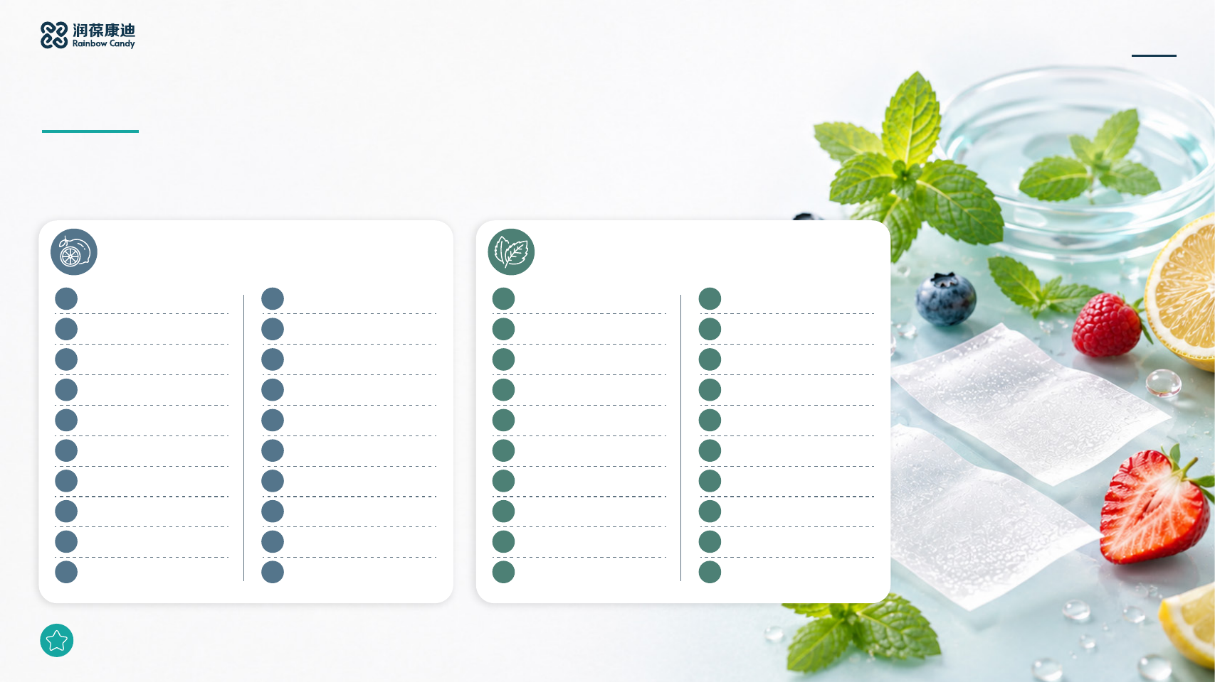
HYTAN BIO TECH
ORAL FILM INNOVATION
Flavor Customization
A broad selection for different markets, brand positions and consumers, with custom flavor profiles available for each
project.
Blended Flavors
Mint Flavors
1
Blueberry & Sour Raspberry
11
Orange, Mango &
1
Cool Mint
11
Icy Mint
Watermelon
2
Lemon & Mango
12
Strawberry, Peach & Mint
2
Wintergreen
12
Classic Mint
3
Juicy Gummy Candy
13
Strawberry & Kiwi
3
Spearmint
13
Peppermint
4
Bubblegum
14
Lemon & Lime
4
Icy Green Mint
14
Ice Mint
5
Cherry, Lemon & Blue
15
Blueberry, Lemon & Mint
5
Vanilla
15
Herbal Mint
Raspberry
6
Fruit Hard Candy
16
Watermelon, Strawberry &
6
Spicy Cool Mint
16
Chewing Gum Mint
Mint
7
Strawberry & Watermelon
17
Peach, Pineapple & Mint
7
Herbal Mint
17
Extra Cool Mint
8
Raspberry & Lemon
18
Raspberry Lemonade & Mint
8
Fresh Mint
18
Licorice
9
Acai & Strawberry
19
Mango, Strawberry & Mint
9
Menthol
19
Extra Cool Mint
10
Cherry & Lemon
20
Pineapple & Coconut
10
Crystal Mint
20
Strong Mint
Additional flavors can be customized on request.
28
Notes:
Content source: the user-supplied Chinese oral film brochure, page 28. Brand and contact details follow the user's instructions. Visual references: https://www.oralstripsoem.com/ and https://www.petoralstrips.com/ .

Slide 29

HYTAN BIO TECH
ORAL FILM INNOVATION
Flavor Customization
A broad selection for different markets, brand positions and consumers, with custom flavor profiles available for each
project.
Fruit Flavors
1
Icy Citrus
11
Blueberry
21
Banana
31
Icy Peach
2
Tropical Fruit
12
Cantaloupe
22
Icy Watermelon
32
Strawberry & Watermelon
3
Mixed Berries
13
Peach
23
Icy Cherry
33
Berry Mint
4
Apple
14
Lemon
24
Peach
34
Triple Berry
5
Coconut
15
Strawberry
25
Lychee
35
Sweet Crisp Apple
6
Grape
16
Icy Watermelon
26
Sweet Orange
36
Black Cherry
7
Honey & Cranberry
17
Pineapple
27
Icy Blueberry
37
Raspberry
8
Mango
18
Icy Lemon
28
Icy Lemon
38
Passion Fruit
9
Cherry
19
Icy Lychee
29
Tropical Pineapple
39
Dragon Fruit
10
Red Berries
20
Strawberry
30
Peach
40
Citrus
Additional flavors can be customized on request.
29
Notes:
Content source: the user-supplied Chinese oral film brochure, page 29. Brand and contact details follow the user's instructions. Visual references: https://www.oralstripsoem.com/ and https://www.petoralstrips.com/ .

Slide 30
HYTAN BIO TECH
Custom Oral Film Solutions for Global Health Brands
Email
info@hytanbio.com
WhatsApp
+852 6240 8962
Website
https://www.hytanbiotech.com/
Hongkong Hytan Biotech CO. Ltd
Notes:
Content source: the user-supplied Chinese oral film brochure, page 30. Brand and contact details follow the user's instructions. Visual references: https://www.oralstripsoem.com/ and https://www.petoralstrips.com/ .

